Slide 1


Geometric Analysis Based Algorithms for Effective Representation and Detection of Curves with Application to Tracking Moving Dim Target
Advisor: Prof. Ofer Levi
By: Galit Volpert

Slide 2
Presentation Outline
Motivation
Objectives
Background
SHAS vs other X-ray approaches
Dynamic SHAS
Dim Target tracking application
Experiments methodology & Results
Discussion & Conclusions

Slide 3
Motivation
Multiscale Geometric Analysis
Detect, organize, represent, and manipulate
data
which nominally span a high-dimensional space
but
which contain important features
which are approximately concentrated on lower-dimensional subsets (curves, sheets, etc.).
http://www.ipam.ucla.edu/programs/long-programs/multiscale-geometry-and-analysis-in-high-dimensions/
Notes:
Works done in the scientific area that deals with…..

Slide 4
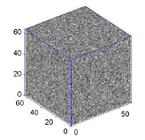
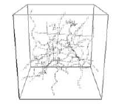
Motivation
Data of Interest
n³ – voxels (cube), f(x,y,z)
-point field
Contains filaments and noise
Notes:
אלמנטים חוטים

Slide 5
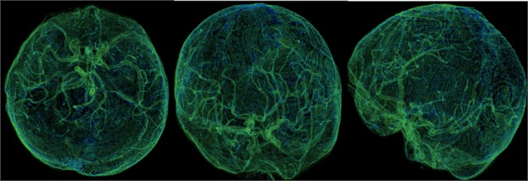
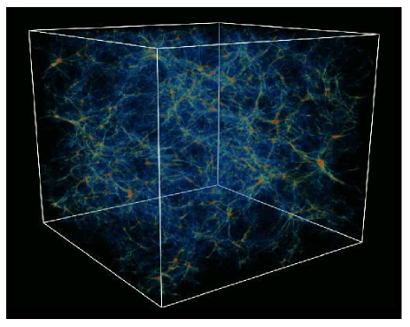

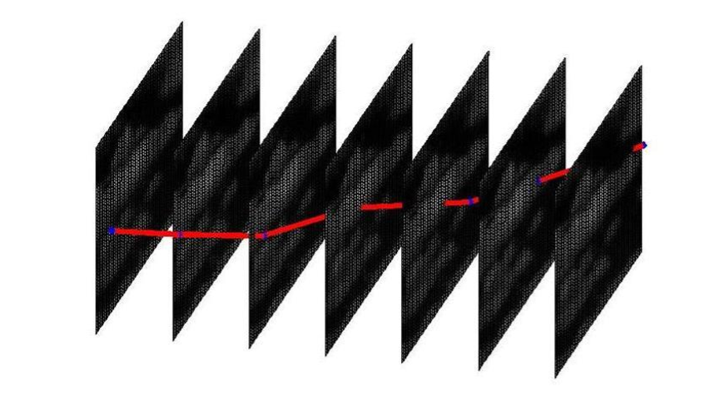
Motivation
Applications
Medical and Biological Imaging
Astronomy
Dim Moving Objects Tracking
Mehul P. Sampat, Alan C., Bovik B., Mia K. Markey, Classification of mammographic lesions into BI-RADS shape categories using the Beamlet Transform
https://www.jvejournals.com/article/20724
D. L. Donoho a, O. Levi a, J.-L. Starck b and V.J.Mart´ınez c ,Multiscale Geometric Analysis for 3-D Catalogues
https://www.pinterest.com/pin/490540584389823063/

Slide 6
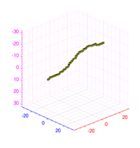
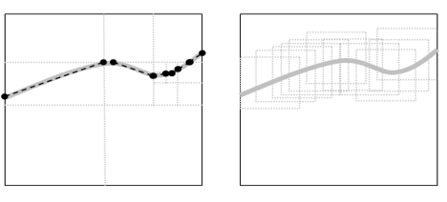
Motivation
Dim Moving Objects Tracking
Man-made moving target.
A dim point target.
Low SNR (barely seen by naked eye).
Multiscale
Dynamic - Mono-scale
?
Notes:
Our interest is in the detection of a sub-pixel target, which is significantly smaller than pixel size, where there is no need to take into account the target point spread function, which is assumed to have its entire support inside a single pixel.
Multiscale based algorithm – develop by Boris Efrati in its thesis
Dynamic Mono-scale based algorithm – this thesis

Slide 7
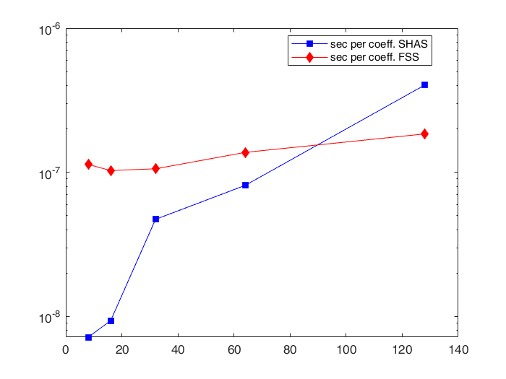
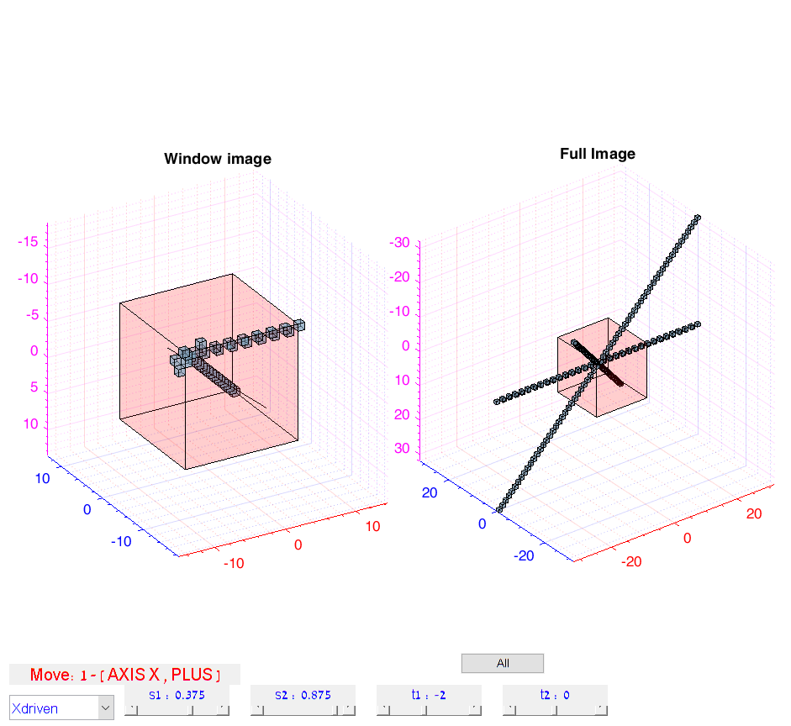
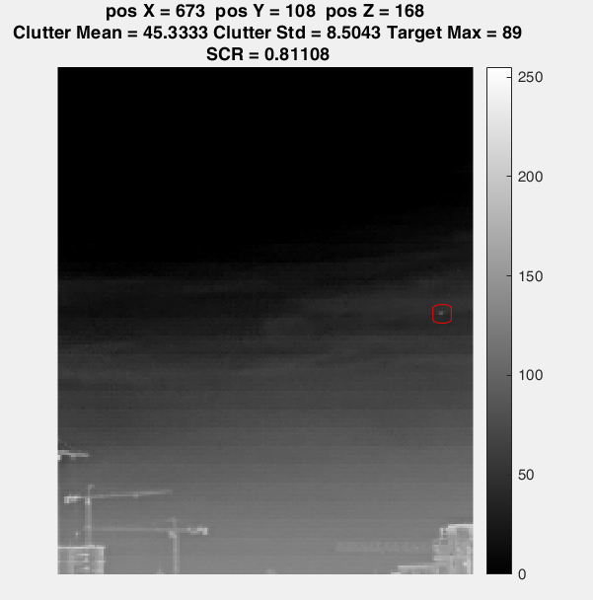
Objectives
Validate the accuracy and efficiency of the Geometric approach X-ray transform algorithm named SHAS by comparing to other discrete X-Ray transform algorithm.
Analyze and present the Dynamic SHAS as a computationally efficient algorithm for dynamically computing X-Ray coefficients inside a sliding window.
Develop Dynamic SHAS based tool for tracking a dim target.

Slide 8
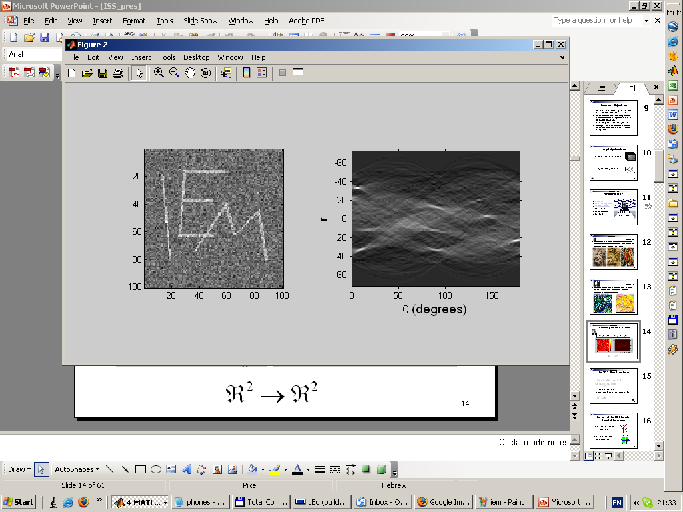
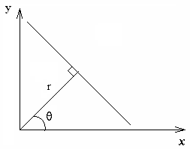
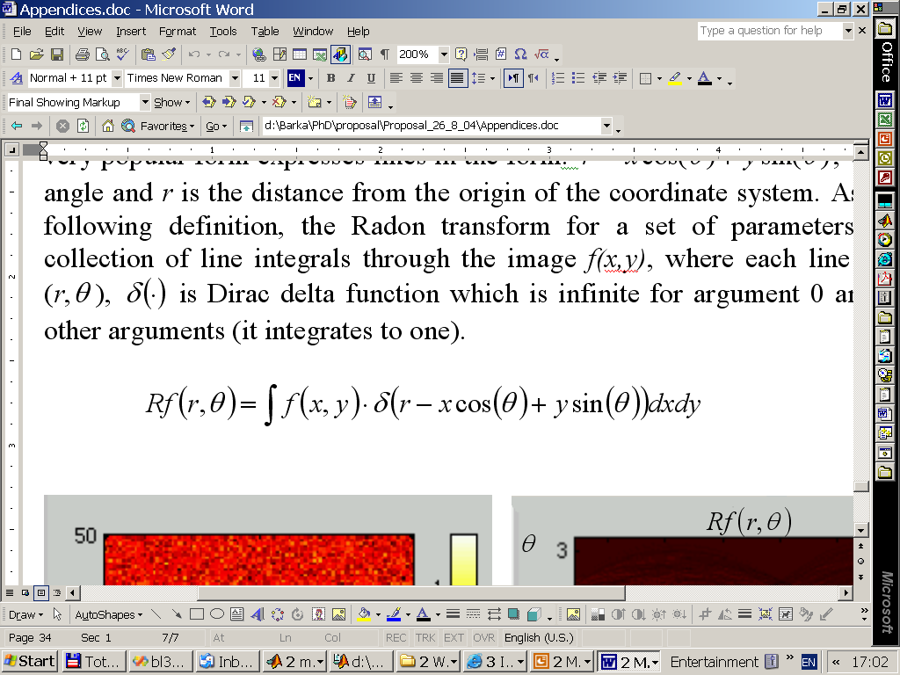
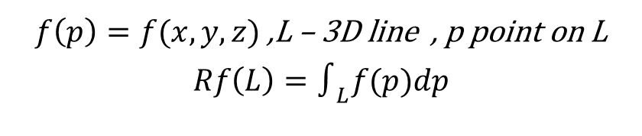
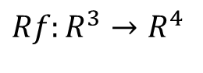
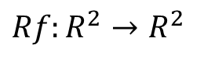
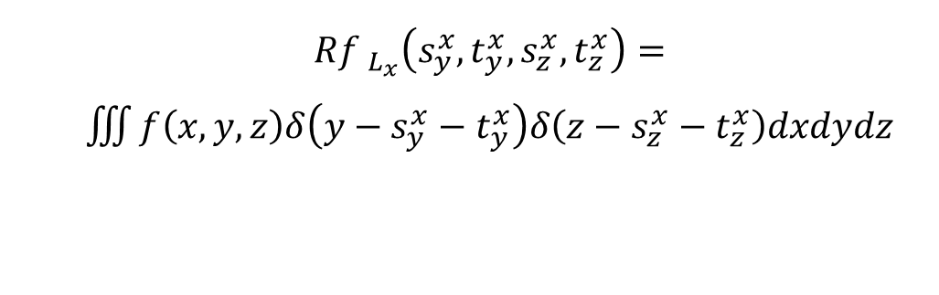
Background
X-Ray Transform
An integral transform mapping spatial data into the parametric space of line integrals
2D 3D
$f\left(p\right)=f(x,y,z)$ ,L – 3D line , p point on L
$$Rf\left(L\right)=∫_{L}f(p)dp$$
$${Rf }_{L_{x}}\left(s_{y}^{x},t_{y}^{x},s_{z}^{x},t_{z}^{x}\right)=$$
$\iiint{f\left(x,y,z\right)δ\left(y−s_{y}^{x}−t_{y}^{x}\right)δ\left(z−s_{z}^{x}−t_{z}^{x}\right)dxdydz}$
$${Rf:R}^{2}→R^{2}$$
$${Rf:R}^{3}→R^{4}$$
Notes:
$\text{point} \text{and} \text{unit} \text{vector} R^{6}→R^{4}$

Slide 9
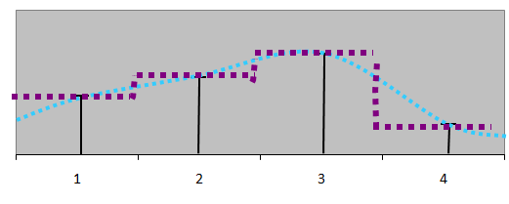
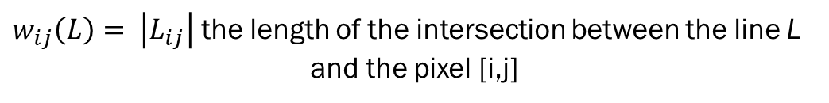
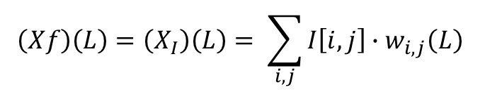
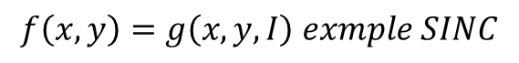
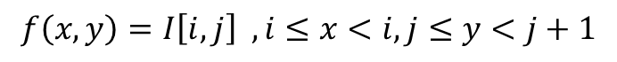
Background
Discrete X-ray transform
Interpolation Scheme
0
9
1
9
10
5
3
10
6
8
10
3
9
3
8
4
Piecewise constant interpolation – interpolation of order zero
“smooth” interpolation – interpolation of higher orders
$$f\left(x,y\right)=I\left[i,j\right] ,i≤x<i,j≤y<j+1$$
$$f\left(x,y\right)=g\left(x,y,I\right) exmple SINC$$
$$\left(Xf\right)\left(L\right)=\left(X_{I}\right)\left(L\right)= \sum_{i,j}{I\left[i,j\right]∙w_{i,j}\left(L\right) }$$
$w_{ij}\left(L\right)= \left|L_{ij}\right|$ the length of the intersection between the line L
and the pixel [i,j]
Notes:
The X-Ray transform is not uniquely defined in the discrete case because integration over a discrete array is not well defined, and requires a choice of interpolation of the discrete data into the continuous domain so the integral can be evaluated.
The Piecewise constant interpolation - widely used in image processing, as it is simple and consistent with the image display on the computer display
In the discrete case, the integral is replaced by a summation operator, and the line integral is defined as a weighted sum.

Slide 10
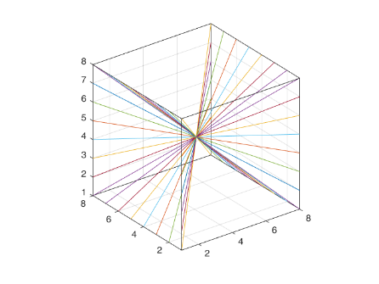
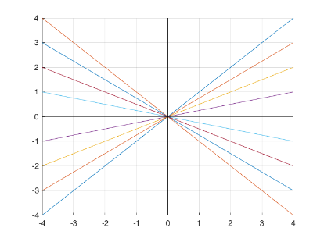
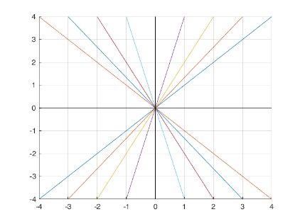
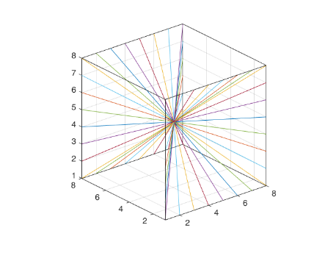
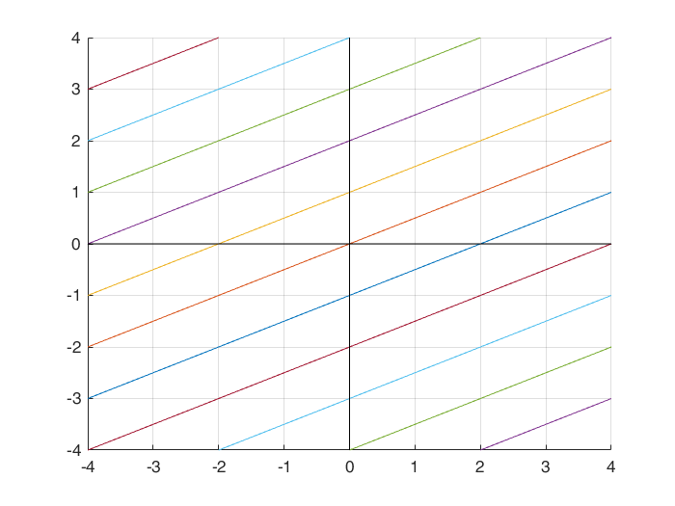
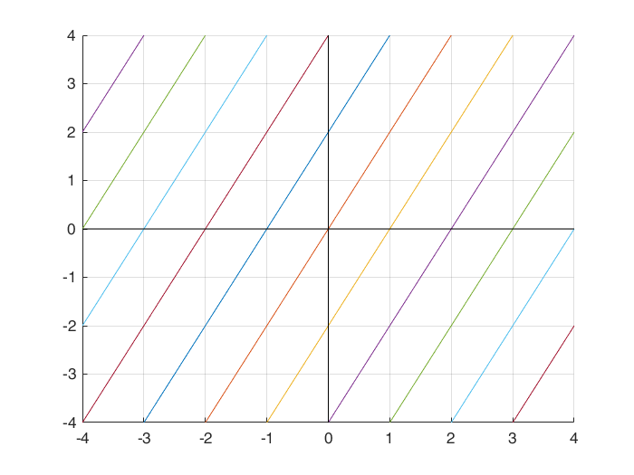
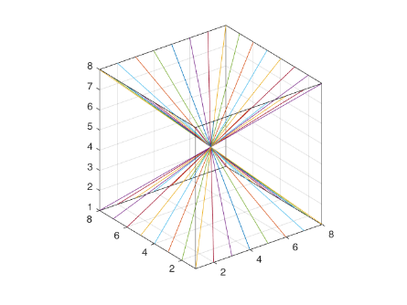
Background
Discrete Parameterization of Line Segments
Slope-Intercept System
Fixed intercept, varying slope
X-driven
X-driven
Y-driven
Y-driven
Fixed slope, varying intercept
Z-driven
X-driven
Y-driven
Notes:
Another aspect is choosing expressive set and parameterization of line segments for line integration
This system of lines corresponds to a family of lines that are equally sampled with respect to their slopes and not with respect to their angles, and the uniform spacing of lines in each projection varies with respect to the slope. This is not the natural choice and might be problematic for reconstruction applications like CT, but for the application of curve detection , it is sufficient.

Slide 11
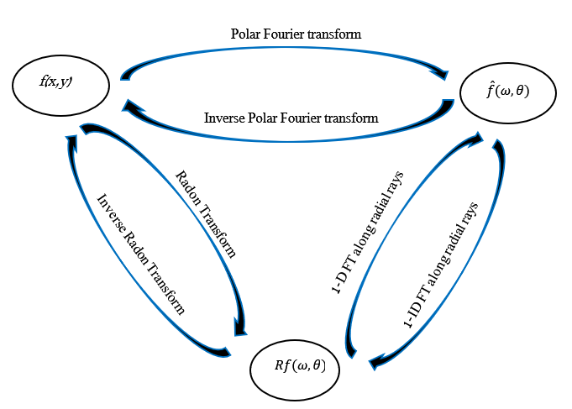
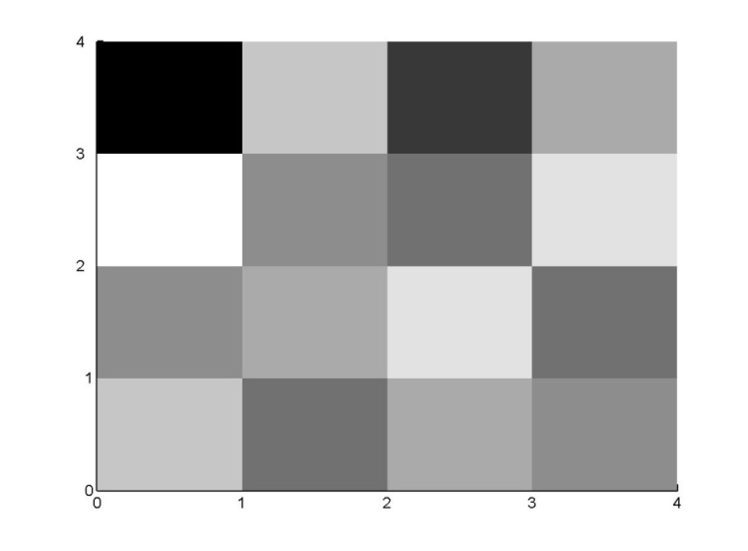
Background
Computation of the X-ray Transform
Direct evaluation methods Fourier domain based methods
0
9
1
9
10
5
3
10
6
8
10
3
9
3
8
4
Equivalent to computing integrals over trigonometric interpolation of the sampled image. Tied to slope-intercept system.
Computational Complexity – O(log(N)) per coefficient
Computational Complexity – O(N) per coefficient
Fast Slant Stack (2003), Averbuch et. al.
Notes:
The FSS Algorithm developed by Averbuch et al. [3] computes a discrete 2D Radon Transform. The algorithm is based on the relation between the Radon (X-Ray) transform and the Fourier space, defined by the Projection-Slice Theorem, also known as the Central-Slice Theorem.

Slide 12
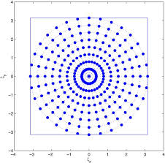
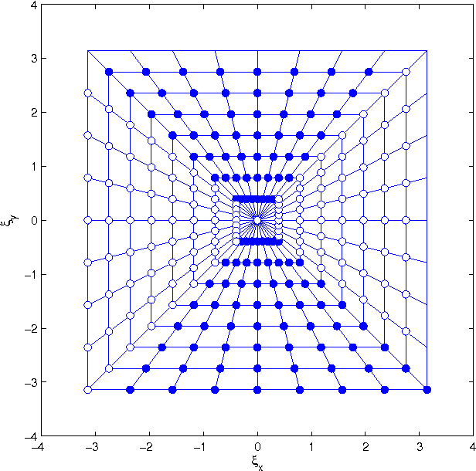
Background
Computation of X-ray
Fourier domain based methods
Polar
Pseudo -Polar
https://www.semanticscholar.org/paper/1-Introduction-1-.-1-Polar-Fourier-Transform-Averbuch-Coifman/7666cfa5840217c65536bf6053268b72b50660c3
Notes:
The projection slice theorem can be used for indirect computation of the radon transform by applying first a polar or polar like Fourier transform following a series of 1D FFT. The main drawback of this approach is that there is no fast and exact polar FFT, and therefore, one needs to compromise either on the computational complexity or the accuracy when computing polar Fourier transform. In order to overcome that, the FSS algorithm uses a fast and exact polar like Fourier Transform called the Pseudo-Polar FFT. The computational complexity of the pseudo polar FFT, (as well as for the entire FSS algorithm), is $O(n^{2}log(n))$. The pseudo polar FFT computes the discrete set of Fourier coefficient over the pseudo polar gride
The pseudo polar grid differs from the polar grid by having concentric squares instead of concentric circles. Another difference is that the pseudo polar grid uses equally spaced slopes instead of equally spaced angles. The FSS transform is performed by applying a series of inverse 1D FFT's along the radial lines of the Pseudo-Polar grid. The resulting discrete set of radon coefficients is identical to the slope-intercept system with respect to the grid in the Radon space
The FSS algorithm can be generalized to 3D in several ways. For comparison and analysis, we used a computational approach that utilizes the operation of 3D shiring . Obviously, it is much easier to compute projection, which is a perfect parallel to one of the axis because than it is no more than a summation of rows or columns. So an effective approach for computing projections is first rotating the image in a way the desired projection becomes parallel to one of the axis. The 3D shiring is similar to 3D rotation and computationally efficient

Slide 13
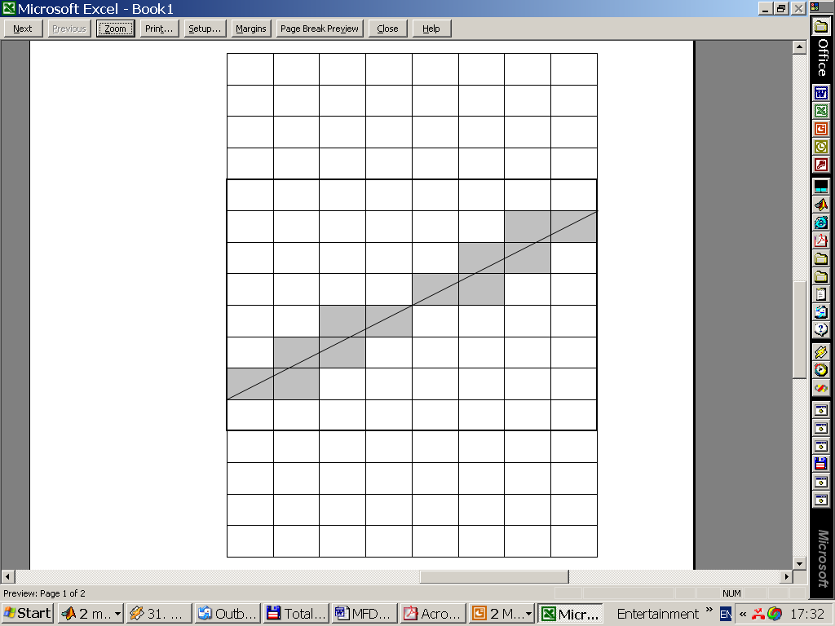
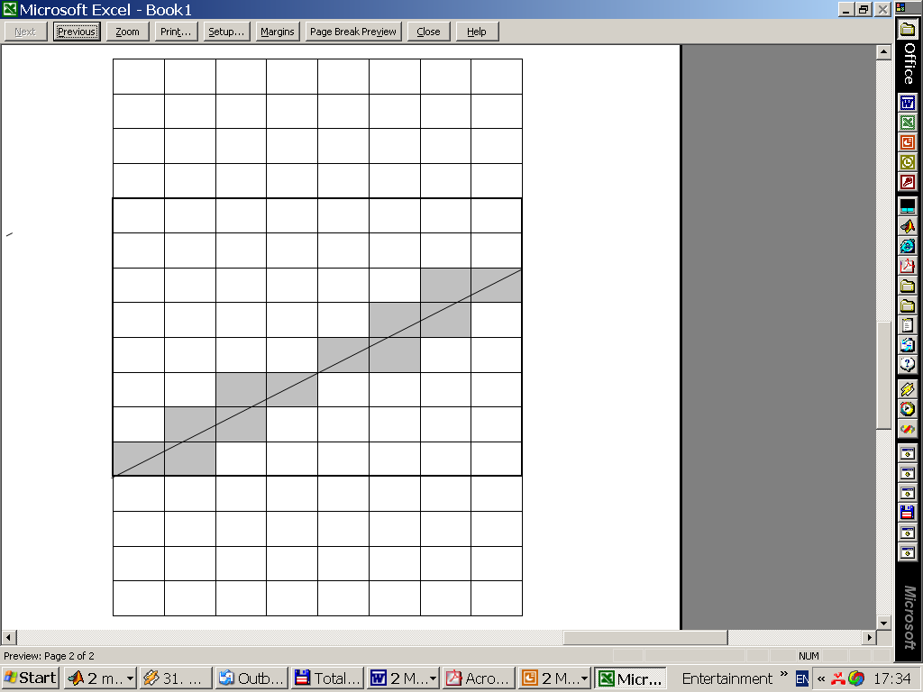
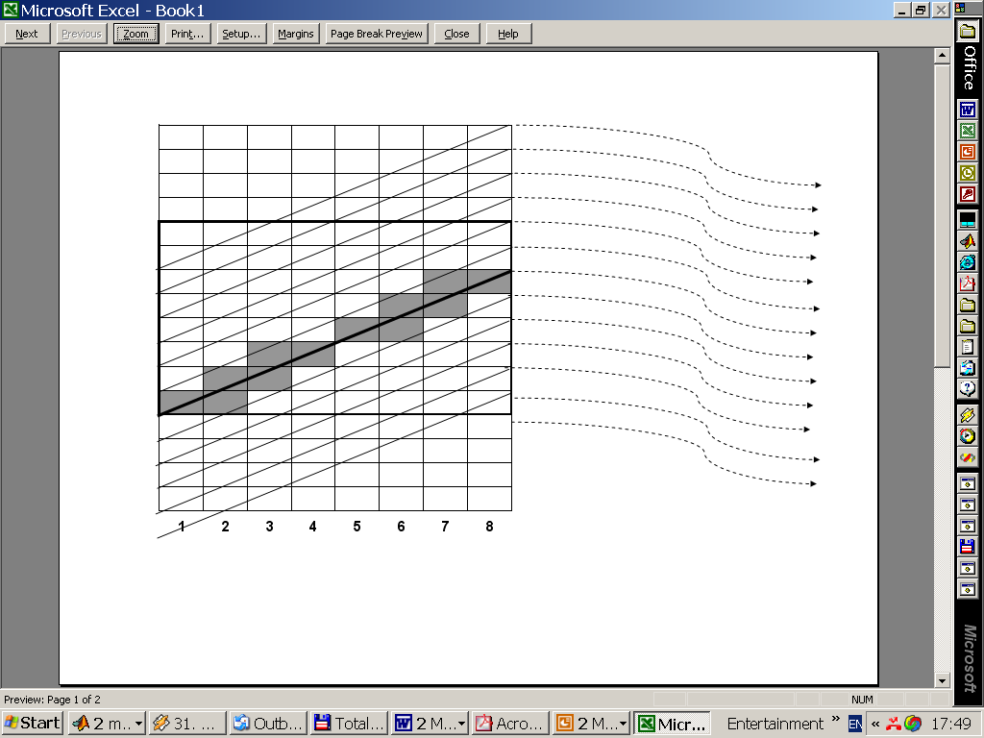
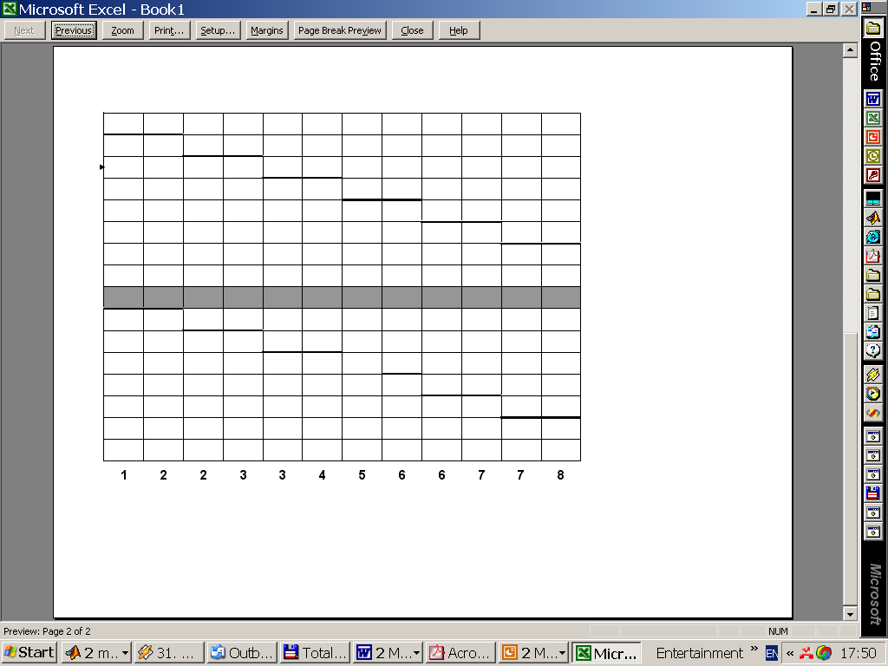
Background
The SHAS Algorithm
Observation
Simultaneous calculation with serial memory access
Notes:
I’ll start by demonstrating the main ideas in 2D …
The distribution of weights for line integral is similar for parallel line segments up to appropriate shifts

Slide 14
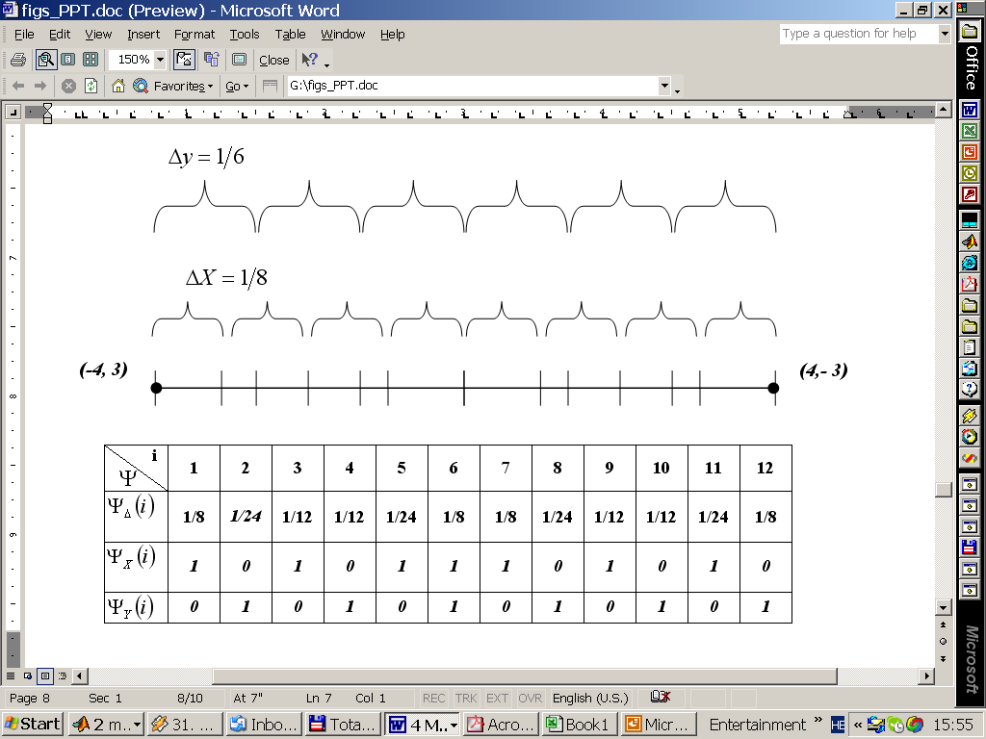
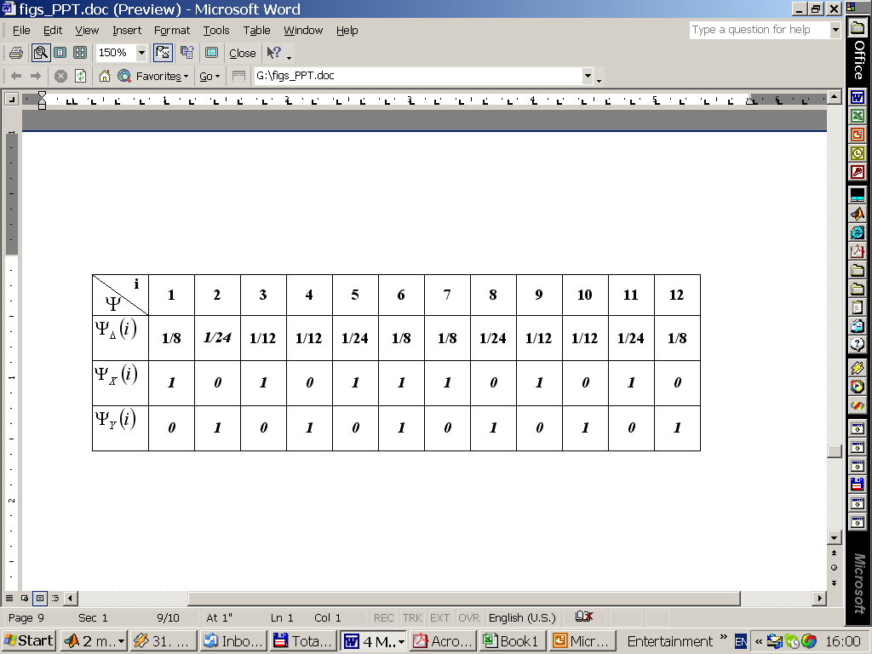
Background
The SHAS Algorithm
Merging Series of Grid Intersections 2D
-8 -7 -6 -5 -4 -3 -2 -1 0 1 2 3 4 5 6 7 8
(-4,3)
(-3,3)
(-3,2)
(-2,2)
(-2,1)
-4 -3 -2 -1 0 1 2 3 4

Slide 15
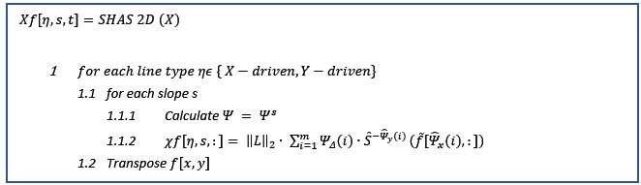
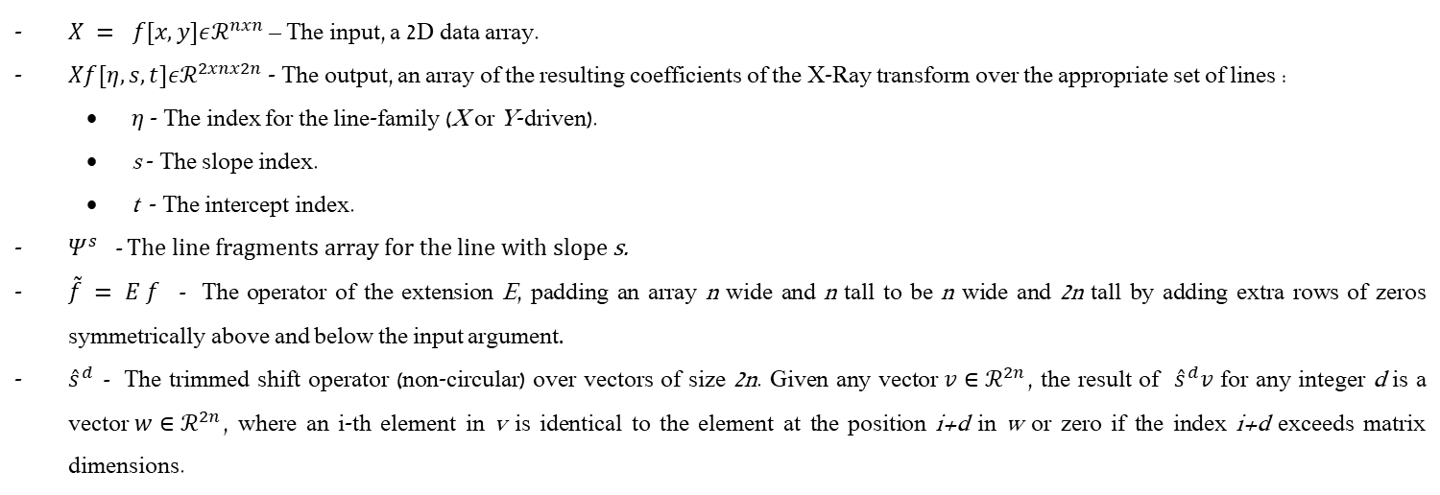
Background
The SHAS Algorithm
$X = f[x,y]εℛ^{nxn}$ – The input, a 2D data array.
$Xf[η,s,t]εℛ^{2xnx2n}$ - The output, an array of the resulting coefficients of the X-Ray transform over the appropriate set of lines :
$η$ - The index for the line-family (X or Y-driven).
s - The slope index.
t - The intercept index.
$Ψ^{s}$ - The line fragments array for the line with slope s.
$\tilde{f} = E f$ - The operator of the extension E, padding an array n wide and n tall to be n wide and 2n tall by adding extra rows of zeros symmetrically above and below the input argument.
${\hat{s}}^{d}$ - The trimmed shift operator (non-circular) over vectors of size 2n. Given any vector$v∈ℛ^{2n}$, the result of ${\hat{s}}^{d}v$ for any integer d is a vector$w∈ℛ^{2n}$, where an i-th element in v is identical to the element at the position i+d in w or zero if the index i+d exceeds matrix dimensions.

Slide 16
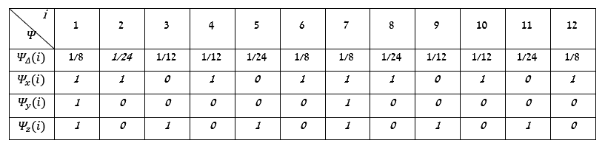
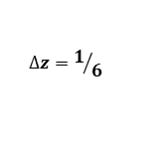
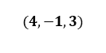
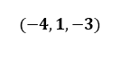
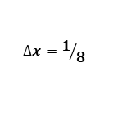
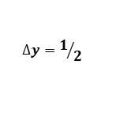
Background
The SHAS Algorithm
Merging Series of Grid Intersections 3D
$$∆z=1/6$$
$$∆y=1/2$$
$$∆x=1/8$$
$$(−4,1,−3)$$
$$(4,−1,3)$$
Notes:
The same idea in 3D

Slide 17
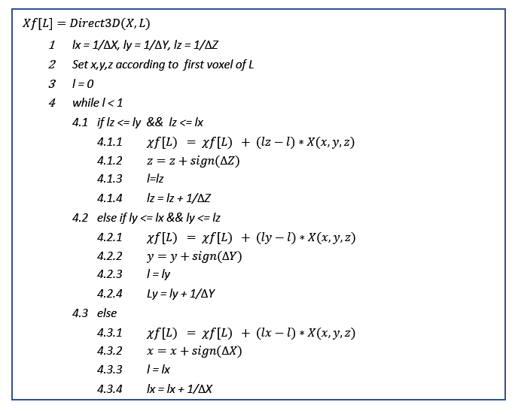
Background
The SHAS Algorithm
Computation of the 3D X-ray Coefficients
Notes:
merging three equispaced sequences defined by parameterizing the line L using a parameter $0≤ t ≤ 1$ such that L(t) = {x(t),y(t),z(t)} with L(0)=$v_{0}$ and L(1)=$v_{1}$($v_{0},v_{1}$the cube voxels corners, which are the end points of the line segment L). Defining $∆_{x}=x_{1}−x_{0} ,∆_{y}=y_{1}−y_{0} ,∆_{z}=z_{1}−z_{0}$the line segment L intersect a YZ-plane whenever t is a multiple of $1/{\left|∆_{x}\right|}$, an XZ--plane whenever t is a multiple of $1/{\left|∆_{y}\right|}$, and a XY-plane whenever t is a multiple of $1/{\left|∆_{z}\right|}$

Slide 18
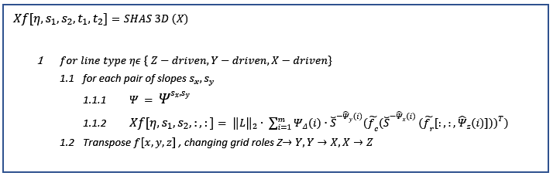
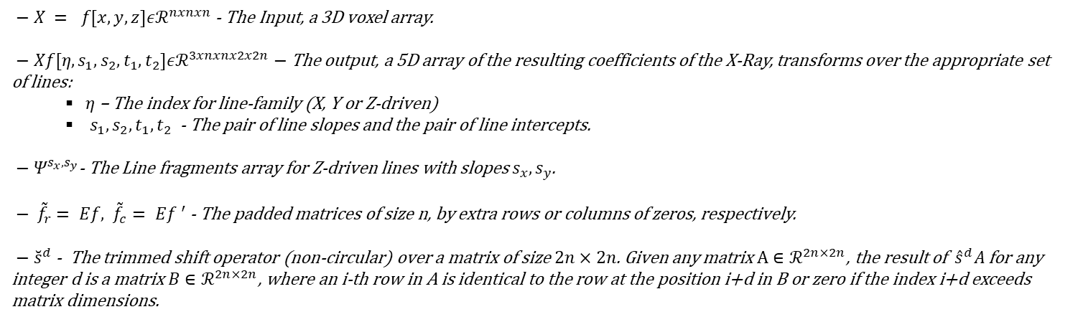
Background
The SHAS Algorithm
$− X = f[x,y,z]εℛ^{nxnxn}$ - The Input, a 3D voxel array.
$− Xf[η,s_{1},s_{2},t_{1},t_{2}]εℛ^{3xnxnx2x2n}−$The output, a 5D array of the resulting coefficients of the X-Ray, transforms over the appropriate set of lines:
$η$ – The index for line-family (X, Y or Z-driven)
${ s}_{1},s_{2},t_{1},t_{2}$ - The pair of line slopes and the pair of line intercepts.
$− Ψ^{s_{x},s_{y}}$- The Line fragments array for Z-driven lines with slopes $s_{x},s_{y}$.
$− {\tilde{f}}_{r}= Ef, {\tilde{f}}_{c}= E{f }^{′}$ - The padded matrices of size n, by extra rows or columns of zeros, respectively.
$− {\breve{s}}^{d}$ - The trimmed shift operator (non-circular) over a matrix of size $2n×2n$. Given any matrix$A∈ℛ^{2n×2n}$, the result of ${\hat{s}}^{d}A$ for any integer d is a matrix$B∈ℛ^{2n×2n}$, where an i-th row in A is identical to the row at the position i+d in B or zero if the index i+d exceeds matrix dimensions.

Slide 19





SHAS vs other X-ray transform approaches
t (sec)
2D
 | Direct Evaluation | Two-Scale Recursive approximations | Fast Slant Stack | SHAS
Accuracy | $${High}^{(1)}$$ | $${Low}^{(3)}$$ | $${High}^{(2)}$$ | $${High}^{(1)}$$
Time Complexity (Per Coefficient) | $$O(n)$$ | $$O(log n)$$ | $O(log n)$ with a high constant factor | $O(n)$ with a low constant factor
Memory Complexity | ${O(n^{2})/O(n^{4}) }^{(4)}$ | $${O(n^{2})/O(n^{4}) }^{(4)}$$ | $${O(n^{2})/O(n^{4}) }^{(4)}$$ | $${O(n^{2})/O(n^{4}) }^{(4)}$$
Memory Access | Not serial | Not serial | Serial | Serial
Line Set Flexibility | High | High | Very Low | Low
Image side size
t (sec)
1 - Exact for Piecewise constant representation of the image.
2 - Exact for representing the image as smoothed trigonometric Interpolation of a sample pixel value.
3 - Relatively Coarse interpolation.
4 - 2D image / 3D image.
3D
Image side size
Notes:
When applying The FSS transformation on an image with a single line, the FSS coefficients are more scattered than for the SHAS ones as there are based on Dirichlet kernel . The difference gets smaller and smaller when n increases. The SHAS is more robust as it includes only simple arithmetic operations like summation and multiplication vs. the FSS, which uses Fourier based interpolation.
Theoretically, the time complexity of the transforms operation per coefficient is O(n) for the SHAS algorithm and $O(log n)$ for the FSS algorithm for a $n×n$ image. However, although the FSS is asymptotically faster, its constant multiplier can be quite significant as it involves the application of the fractional Fourier Transform, which is more expensive than a standard FFT and uses complex arithmetic's. On the other hand, the constant multiplier of the SHAS algorithm is about two and involves summation and multiplication of real numbers. This explains the comparison results seen in the next figures where the SHAS is faster for small-medium image sizes.
The SHAS algorithm allows some flexibility regarding the choice of line set; Unlike the FSS, there are no constraints on the slopes, and any slope density and angular spacing are allowed. The only constraint is on the set of lines, which is limited to subsets of parallel equispaced lines with vertical or horizontal shifts in the 'basically' vertical or horizontal sets. On the other hand, the FSS algorithm is restricted to the pseudo-polar grid, which forces the system of lines to be equispaced with respect to the sloped.

Slide 20

SHAS vs other X-ray approaches
The Two Scale Recursion
Notes:
Generally, an approximation of each line segment at the coarse-scale can be made by a connected chain of lines segment in the next finer scale.
the coarse-scale can be computed by summing the appropriate X-Ray coefficients from the next finer scale. Despite its elegant low theoretical complexity and compatibility with the multiscale beamlet structure, the results are not exact (except the case where the coarse-scale line has the same slope as its finer scale parts), and to increase the level of accuracy, one must apply oversampling or accurate and expensive interpolation. The second drawback of this approach is that despite the theoretical $O(\log{n)}$ time complexity per coefficient in practice, the running time is much slower because of the required non-sequential access to the coefficients space, which is much bigger than the image space, especially in higher dimensions

Slide 21



Dynamic SHAS
2D
As
X-driven
Y-driven
Notes:
We first present the strategy for the 'Step Right' case. We denote by $∆_{x}^{0}(s)$ a zero-intercept offset as the smallest distance between the interception point of an X-driven line segment with slope s and the origin, $∆_{y}^{0}(s)$ is defined similarly for the Y-driven line segment.
For the X-driven lines, we need to recalculate the zero-intercept offset for each slope to update the line fragments array. Because the magnitude of the slopes is smaller or equal to one, we can ensure that its absolute zero-intercept offset value will never be higher than 0.5 by performing a shift of one if needed. Then we update the coefficients according to $v^{in}$ , $v^{out}$ and the corresponding updated fragment-array columns, where each coefficient is updated for the first or last or both columns instead of for all columns as in SHAS, and with two or fewer operations per column
Updating the coefficients of the Y-driven line is based on a consequent walk through adjacent pixels in $v^{in}$ , $v^{out}$and adding or subtracting its weights to an appropriate coefficient with the current slope. Some coefficients may require up to n operations, and they are compensated for by a large set of coefficients that require only re-indexing.
The procedure for 'Step Left' is the same as 'Step Right' after reversing the order of slopes and column vectors $v^{in}$, $v^{out}$. The procedures for 'Step Up' and 'Step Down' are almost like 'Step Right' and 'Step Left,' where the X-driven lines are updated with Y-driven procedures and vice versa.

Slide 22

Dynamic SHAS
3D
Notes:
The Dynamic SHAS average update times for a step in each direction (X, Y, Z) for any specific driven lines were registered using C implementation with double precision running on Intel® Core™ i7-6700K CPU @ 4.00GHz
The reduced complexity:
The coefficients update takes roughly half of the SHAS update time.
The coefficients update in the X-direction takes around a third of the Y, Z direction update time.
The Z-direction update takes a little longer as C implementation use Row-major order, and our Z-direction update implementation takes column-major order, which is less cache-aware.

Slide 23

Dynamic SHAS
3D– X-Driven update
Notes:
The Strategy for the 3D case is based on the same principles for the 2D scenario with the following adjustments; The sliding window can move 'Step Forward' (Plus) and 'Step Backward' (Minus) in three different directions according to the axes X, Y, and Z. Each move affects the coefficients of the three sets of lines X-driven, Y-driven, and Z-driven.
We first present the strategy for the 'Step Forward' in the X direction: As in the 2D case we need to recalculate zero-intercept offsets for each slope to recalculate the line fragments array as we did in 3D SHAS. The update of the coefficients is done according to the ${slice}^{in}$ and ${slice}^{out}$ principle and the corresponding fragment-array columns, where each coefficient is updated for only the first or last or both slices instead for all slices as in SHAS with up to 3 or fewer operations

Slide 24

Dynamic SHAS
3D update

Slide 25

Dynamic SHAS
3D– X-Driven update

Slide 26

Dynamic SHAS
3D– Y-Driven update
Notes:
The Y-driven dynamic updates are different from the X-driven updates as described for the 2D, where the additional 'fragment z' row determines a shift. As for the 2D case, some coefficients may require up to n operations, compensated by a large set of coefficients that require only re-indexing.

Slide 27

Dynamic SHAS
3D– Y-Driven update

Slide 28

Dynamic SHAS
3D– Z-Driven update
Notes:
The Z-driven dynamic update is similar to the strategy as for the Y-driven and is illustrated. As for the 2D case, some coefficients may require up to n operations, compensated by a large set of coefficients that require only re-indexing.
The procedure for 'Step Backward' is the same as 'Step Forward' after reversing the order of ${slice}^{in}$ and ${slice}^{out}$. The procedures for moving in the Y and Z direction cases are almost like in the X direction case where, for the Y direction, the Y-driven lines are updated with X-driven procedure, the Z-driven lines are updated with the Y-driven procedure, and the X-driven lines are updates with the Z-driven procedure. For the Z direction, in a similar way, the Z-driven lines are updated with the X-driven procedure, the X-driven lines are updated with the Y-driven procedure, and the Y-driven lines are updated with the Z-driven line procedure.

Slide 29

Dynamic SHAS
3D– Z-Driven update

Slide 30
Dynamic SHAS
Running Time
The running time for one step in all directions
16-pixels window 2.5msec -> 400 fps
8-pixels window 250µsec -> 4000 fps
Visual C - Intel® Core™ i7-6700K CPU @ 4.00GHz
Notes:
The algorithm can process images at the frame rate of the camera
The notion of real-time display is not really tied to a specific frame rate - it could be defined as the minimum frame rate at which movement is perceived as being continuous. So for slow moving objects in a visual frame (e.g. ships in a harbor, or stars in the night sky) a relatively slow frame rate might suffice, whereas for rapid movement (e.g. a racing car simulator) a much higher frame rate would be needed.
Intel® Core™ i7-6700K CPU @ 4.00GHz
(Without any parallization )

Slide 31

Dim Target tracking application
Target Tracking System
Notes:
Surveillance systems rely on remote sensors that sense energy emitted from or reflected by an object (or several objects) of interest and other sources of energy like clutter. For civilian and military applications with far imagery distance like anti-missile systems, early-warning systems, and infrared search and track systems, the target of interest often appears as a dim point embedded in a heavy cluttered background. The dim point target is typically characterized by its temporal dynamics rather than its shape (spatial) characteristics

Slide 32
Dim Target tracking application
Dim Target Tracking challenges
s
Clutter and noise
Maneuverable target
Uncertain Data association
Real-time
Notes:
Clutter and noise – From background objects like clouds, sunlight spots, and sensor noise that can cause false tracking and tracks detection misses. This issue can be handled by a background suppression (whitening( process as a part of the preprocessing stage or as an integral part of the tracking algorithm, with a goal, to suppress the clutter/ background without affecting the target signature. Article [24] presents an overview of current approaches as well as convolutional neural network-based approach for enhancement of infrared images containing a dim target.
Maneuverable target - Tracking Maneuvering targets is complicated due to the fact that acceleration is hard to model, as it can be induced by a variety of sources like atmospheric disturbances, which can cause unpredicted temporal acceleration. Sophisticated models are needed to model target motions [25, 26], and sensor measurements (like motion [27] or pixeled [28]), causing the estimation to be a nonlinear and non-Gaussian problem.
Uncertain Data association – In the broader subject of motion-based Multitarget Tracking (MTT), in addition to the target state estimation as for Single Target Tracking (STT), data association is a significant issue, since in the case of multitarget the association between measurements and tracks are uncertain. The tracking algorithm addresses this issue explicitly or implicitly by advance and sophisticated modeling [6].
Real-time – Often, it is required to finish processing a frame (or batch of frames) before the next frame arrives. Furthermore, the unpredictable and varying maneuvers of the dim target dictate a high frame rate for practical tracking purposes.

Slide 33
Dim Target tracking application
Tracking Algorithms
Detect Before Track (DBT)
Threshold measurement model
High SNR scenarios
Track Before Detect (TBD)
whole raw sensor
Using a multi-frame to accumulate target information
Low SNR scenarios
Complex computation and delay
Notes:
Detect Before Track (DBT)
The general scheme in the DBT category involves detections from the sensor measurements, typically using the threshold measurement model [28], and then the thresholded measurements are fed into the tracking algorithm. The measurement-track association typically handled before the state estimation. In general, DBT methods attain good performance when tracking objects in the scenarios of high SNR. However, in low SNR, the tracking tends to fail as a large number of outliers are detected, or the target might be completely missed. A detailed description of the DBT approach can be found in [6]. The most common approaches for data association include multiple hypothesis tracking (MHT), joint probabilistic data association (JPDA), and random finite sets (RFS), and the most common approaches for estimation of target state filtering include Kalman filter and particle filter described in [30].
Track Before Detect (TBD)
This category is also known as joint detection and tracking. The general scheme involves using the whole raw sensor data as input for tracking where relatively multiple trajectories are estimated, but no commitment is initially made for any specific trajectory. Target detection is declared after a continual tracking for the trajectory whose posterior probability is the highest. This schema improves tracking performance by using a multi-frame to accumulate target information. As no intermediate detection takes place in TBD, no explicit data association is needed. The advantage of improved performance for low SNR scenarios comes with complex computation and delay in the target tracking. The TBD methods are typically classified into Bayesian (‎2.4.3.2.1) and non-Bayesian (‎2.4.3.2.2) approaches.

Slide 34
Dim Target tracking application
Track Before Detect (TBD) - Tracking Algorithms
Bayesian approaches
Handle complicated target motion using recursive Bayesian filtering approach.
Substantial implementation cost (Particle filter)
Non-Bayesian approaches
Accumulate energy based on the velocity feature & use optimization algorithm.
Efficient algorithms with real-time performance (Hough, Viterbi)
Notes:
Bayesian approaches
In Bayesian TBD approaches, the target state and measurements are described by probability density function (PDF) build from the raw sensor measurements, motions modeling, and target birth/death modeling, then recursive Bayesian filtering is applied to obtain the target state estimation. The two leading families of methods used for recursive Bayesian TBD implementations are particle filtering, and ﬁnite set statistics (FISST) based filtering described in This approach shows good results handling complicated target motion, but in general, the recursive Bayesian filter is computationally intractable and needs numerical approximation resulting in substantial implementation cost.
Non-Bayesian approaches
In non-Bayesian approaches, at each time, the target energy in the last N frames is accumulated based on the velocity feature, and an optimization algorithm is used to ﬁnd the target track. Generally, a batch processing techniques are used where trajectories are estimated in a 3D image (a stack of 2D frames taken in uniform time intervals) with no commitment that they represent a target and only trajectories with a computed posterior probability above a certain threshold declared as targets. The non-Bayesian approaches include algorithms based on methods like multistage hypothesis testing (MHT) , 3D matched filter projective transforms as Hough and Radon [9] and dynamic programming (DP) based on the Viterbi algorithm .
Although the non-bayesian approaches are less commonly used for MTT applications, there are scenarios where the target trajectory constitute a straight line or as a chain of straight line segments (piecewise constant velocity target) assuming that the curved trajectory sampled can be well approximated by breaking it into intervals in which for each interval velocity is treated as a constant. For this kind of particular scenarios, there are efficient versions of non-bayesian algorithms with real-time performance, for example, the Viterbi algorithm used as part of unmanned aerial vehicle (UAV) collision avoidance system and the Hough transform used as part of detecting low radar cross-section targets application.

Slide 35


Dim Target tracking application
Target Model/Measurement Model
scenarios where the target trajectory constitute a straight line or as a chain of straight line segments (piecewise constant velocity target) assuming that the curved trajectory sampled can be well approximated by breaking it into intervals in which for each interval velocity is treated as a constant
$v_{i}={\left[y_{i } {\dot{y}}_{i} { z}_{i} {\dot{z}}_{i}\right]}^{T}$
$v_{i}= A v_{i−1}+ n_{i}$
$A = \left|\begin{matrix}A_{k} & 0 \\ 0 & A_{k}\end{matrix}\right| A_{k}=\left[\begin{matrix}1 & ∆x \\ 0 & 1\end{matrix}\right] n_{i}=\left[\begin{matrix}0 \\ \begin{matrix}n_{yi} \\ \begin{matrix}0 \\ n_{zi}\end{matrix}\end{matrix}\end{matrix}\right]$
${\dot{y}}_{i}$,${\dot{z}}_{i} ≤$ $± 1$ pixel
$n_{i} \sim 𝒩\left(0,σ\right), n_{i}< ± 0.25$pixel
sub-pixel target
entire support inside a single pixel.
$${3D Cube}_{AGWN} \sim 𝒩\left(0,σ\right)$$
$${3D Cube}_{Line\&AGWN} = {3D Cube}_{Line\left(μ=1,σ=0\right)} + \frac{{3D Cube}_{AGWN} }{Noise Level}$$
Notes:
The target state at time $i,v_{i}$consists of the target position and its first derivative.
The next linear stochastic process models the state progression
Where $n_{i}$ denotes a model noise and A denotes the transition matrix
With the next constrains:
Our interest is in the detection of a sub-pixel target, which is significantly smaller than pixel size, where there is no need to take into account the target point spread function, which is assumed to have its entire support inside a single pixel. In all our experiments, we normalize the target intensity to one, and the noise level and resulting SNR are determined accordingly to this normalized value.
-----
we normalize the target intensity to one, and the noise level and resulting SNR are determined accordingly to this normalized value.
The central limit theorem of probability theory indicates that the summation of many random processes will tend to have distribution called Gaussian or Normal.
Jump to search In probability theory, the central limit theorem (CLT) establishes that, in some situations, when independent random variables are added, their properly normalized sum tends toward a normal distribution (informally a bell curve) even if the original variables themselves are not normally distributed

Slide 36





Dim Target tracking application
Dynamic SHAS Based Tracking
Notes:
The windows continue tracking till they got lost event
As we concentrate on one target that start and never die we offer simple paradigm of setting the prediction according to the window with the maximum coeff. Value.
window: 8
target: ImgST2yM075z025.mat
Snr: 3.500000e+00
Overall PD:1 Instantaneous PD:1 Tracking Ratio:1 max step loc:25 max step:2.236068e+00 mean step:6.992903e-01

Slide 37



Dim Target tracking application
Dynamic SHAS Based Tracking
Notes:
Without compromising generality, we assume a square image of side size M=$2^{m}$ and a window of side size $N=2^{n}$, where n<m (zero paddings of the image might be needed when the image size m is nondyadic).
The number of overlapping windows $\left|W\right|$for covering the image is given by:
$\left|W\right| =\frac{{(M−N/2)}^{2}}{{(N/2)}^{2}}$
The number of windows per row or column ${\left|W\right|}_{rc}$ can be expressed as:
${\left|W\right|}_{rc} =\frac{M−N/2}{N/2} = \frac{2M}{N}−1$
And for every window $w_{i}$, $i∈ \{1..E\}$ the window center position $y_{w_{i}}^{0},z_{w_{i}}^{0}$is given by:
$y_{w_{i}}^{0}=(i−\left\lfloor \left. \frac{i}{{\left|W\right|}_{rc}}\right\rfloor {∙\left|W\right|}_{rc})\right.∙N−\frac{N}{2}$ , ${ z}_{w_{i} }^{0}= \left\lfloor \left.\frac{i}{{\left|W\right|}_{rc}}\right\rfloor \right. +1$

Slide 38
Experiments Methodology & Results
Experiments Methodology
SHAS
‘Detection’ criteria
‘Tracking’ criteria
Dynamic SHAS
Straight trajectory
Curved trajectory
Straight with model noise trajectory
Comparison with Viterbi

Slide 39



Experiments Methodology & Results
SHAS - Experiments
‘Detection’ criteria
Statistical hypothesis testing :
$H_{0}: T$he 3D cube contains only noise.
$H_{1} : The$3D cube contains a line with AGWN
$′critical$SNR’ – for $α$ – 5% / $β$- 2% and $α$ – 1% / $β$- 5%
‘Tracking’ criteria
The posterior probability that the 'maximum coefficient' represents:
mode 0 - The exact line.
mode 1 - A line with mid-point aligned to the cube center.
mode 2 - A line with a mid-point with an offset magnitude of one or two (either positive or negative) from the cube center.
'Maximum Coefficient’ Magnitude
 | Straight | Curved
8 - pixels | 2.5 | 3.5
16 - pixels | 2 | ~3
Straight | Min. SNR for $err≤$5% | Min. SNR for $err≤$1%
Mode 0 | 2.5 / 2 | 3.5 / 2.5
Mode 1 | 2.5 / 2 | 2.5 / 2
Mode 2 offset 1 | 2 / 2 | 2.5 / 2
Curbed | Min. SNR for $err≤$5% | Min. SNR for $err≤$1%
Mode 2 Offset 1 | 3.5 / 3.5 | >10 / 8
Mode 2 offset 2 | 2.5 / 2.5 | 3.5 / 3
Minimal SNR assuring the error levels for Straight lines – 8 / 16 - pixels
Notes:
20,000 cases
For the false detection case, we set two levels of significance - $α_{1}= 5\%$ and $α_{2}= 1\%$.We also evaluate the type II error probabilities $β$, the probability of not detecting a line when it exists. We can evaluate the $β^{′}s$ for each SNR because the alternative hypothesis is explicit for a given specific line.
We decide to set fix values for $α$ and then derive the corresponding $β$ and not the other way around because it is more critical for our application to avoid uncontrolled type I error than not detecting a line when there is one based on type II error, as the algorithm can detect the line in the next frame
The Comparison of the statistics of ‘with offset’ to the statistics of lines with 'no-offset':
The results are degraded, and the required $β^{′}s$ achieved by SNR, which is 0.5 higher than in the case of 'no-offset.' This happens since the lines become shorter as the offset increases.
Conclusions regarding the choice of the 'critical value':
For each scenario, we would like to find the lowest SNR for which our statistical decision process meets the type I and type II error probability requirements. Once we find this 'critical SNR,' we know that our method can handle SNR from this value and up but might not function well for lower SNR.
The scenario 'critical value' is determined by the lowest SNR for which the corresponding $β$ meets the type II error requirement of not detecting an existing line.
To determine that a cube contains only-noise, the scenario 'critical value' is used as an upper threshold for the 'maximum coefficient' magnitude.
For detection of lines with an offset from the cube center, we see in the above results a degradation in the $β^{′}s$, so we can conclude that higher 'critical SNR' is needed for this case
-----------------------------------------------------------------------------
the posterior probability of a random event] is the conditional probability that is assigned after the relevant evidence or background is taken into account
Given the empirical distribution, we can evaluate the correct line detection probability when our assumptions hold. We set a few levels for the probability of tracking failure - $5\%, 1\%, 0.1\%,0\%$, and for each level, we evaluate the lowest SNR for which the error probability stays below the given level
Straight:
Mode-1 and Mode-2 offset 1 exhibit higher performance than Mode-0 for every error level.
The 16-pixels lines gain the best predictions for any error levels as expected.
Curved:
16-pixels lines exhibit higher performance results than 8-pixels lines for low error levels
For 16-pixels cube:
For 97% of the curved lines, the 'maximum coefficient' represents a line with mid-point up to one pixel offset from the cube center, for SNR 3.5 and above.
For 99% of the curved lines, the 'maximum coefficient' represents a line with mid-point up to two pixels offset from the cube center at SNR 3 and 100% at SNR 8.
The conclusions regarding the use of the 'maximum coefficient' - line offset as tracking criteria:
Straight lines could be 99% tracked using 16-pixels cube at SNR 2, and using 8-pixels cube at SNR 2.5.
Once we get a 'maximum coefficient' representing a line offset higher or equal to one pixel, we should prefer 16-pixels cube as for low error levels, it is preferred over 8-pixels cube.
--------------
Quarter – offset
There is a slight reduction in the successful tracking probabilities compared with the 'no-offset' case, and the minimal SNR increased by up to 0.5 in most cases.
There is a small number of lines, less than 2%, that cannot be tracked with an offset up to one even for the noise-free case.
For the Mode-2 offset-one case, at SNR 8 and 10, we get a probability slightly higher by up to ~0.5% than for the noise-free case due to noise effect.
From the analysis and results above, we can conclude that :
For both straight lines and curved lines with up to 'quarter-offset,' in order to have the same tracking performance as a line with 'no-offset', the SNR needs to be higher by up to +0.5.

Slide 40






Experiments Methodology & Results
SHAS - Experiments
Straight
Curved
Notes:
No-offset – The line mid-point aligned with the cube center.
Quarter-offset –The line mid-point is in an offset of a quarter of cube side size from the cube center. This offset definition enables us to evaluate the ability to cover the full cube by cubic windows overlapping each other by half of their side size As the cube side size is even number, the center of the cube is not equally spaced from the cube boundary, and we defined:
Plus-quarter offset - An offset of a quarter of the cube side size in the positive direction from the center of the cube.
Minus-quarter offset – An offset in the negative direction from the center of the cube, which is smaller by one pixel from the 'plus-quarter' as the center is shifted by one from its geometric center in this direction.
The curved lines created from joining two different halves of straight-line segments
Group I (high) –
If for any axis
(First half segment, slope index is higher than 'half-horizontal' indices
and
Second half segment, slope index is lower than 'half-horizontal' indices)
or
Second half segment, slope index is higher than 'half-horizontal' indices
and
First half segment, slope index is lower than 'half-horizontal' indices
Group II (med) –
If the conditions of Group I are not satisfied
and
for any axis
Any half segment, slope index is in the 'half-horizontal' indices range
Group III (low) –
If the conditions of Group I and II are not satisfied

Slide 41

Experiments Methodology & Results
SHAS - ‘Detection‘ Experiments
Beta Vs. Snr for 'maximum coefficient,' 'second-largest coefficient,' and 'maximum coefficients difference.'
Notes:
For straights lines: For every SNR and $α,$ the lowest $β^{′}s$ obtained for the 'maximum coefficient,' then for 'maximum coefficient's difference' and the highest is for the 'second-largest coefficient.'
For curved lines: The $β^{′}s$ for the 'maximum coefficient' and 'second-largest coefficients' are very tight up to SNR 3, and then the 'maximum coefficient' gains advantage over the 'second-Largest coefficient.' The 'maximum coefficient difference' has the worst results.
Conclusions regarding the parameter choice for the 'critical value' criteria:
For both line types, the 'maximum coefficient' has shown the best results, and it was decided to use for the detection criteria.

Slide 42


Experiments Methodology & Results
SHAS - ‘Detection‘ Experiments
Straight vs. Curved Vs. Noise - Maximum / Second Largest coefficients magnitude.
Straight vs. Curve – Maximum, Second Largest coefficients magnitude difference
Notes:
-----------------------------------------------------
The 'maximum coefficient' and 'second-largest coefficient' empirical pdf's for noise are almost overlapping and has a smaller mean compared with the case of lines signals as expected.
The 'maximum coefficient' and the 'second-largest coefficient' empirical pdf's for curved lines are respectively closer to each other than for straight lines, especially as the SNR increases and more distinctly for the 16-pixels line
----------------------------
For curved lines, the difference is closed to zero with high probability as the curved line is built from two halves of different straight lines, which can be represented by the two highest coefficients, one for each segment with approximately the same weighted sum.
For straight lines, the likelihood for the difference that is close to zero is minimal, as we expect that a single coefficient will have the best overlap with the line, and the 'second-largest coefficient' will have only partial overlap, so we expect the difference between them to be relatively significant
--------------------
--------------------
The difference between the 'maximum coefficient' and the 'second-largest coefficient' can be used as an indicator to distinguish between straight and curved lines by setting an appropriate threshold.
It is more effective for 16-pixels cube and high SNR.
We will note that this approach is expected to be sensitive to choose of lines and discretization system, and therefore we will not recommend relying on it unless the line discretization is very fine, resulting in a small discretization effect/

Slide 43


Experiments Methodology & Results
Dynamic SHAS - Experiments
 | ST1 | ST2 | CT1 Curvature Medium Low / High | CT2 Curvature Medium Low / High | STwMN
8 - pixels | 3 | $$4^{(1)}$$ | 3 / 5 | 3.5 / 8 | 3.5
16 - pixels | 2 | $${2.5}^{(1)}$$ | 2.5 / 4.5 | 2.5 / 5 | 2.5
${SNR}_{pd=100\%}$ (100% tracking PD at Max. SNR ) for trajectories types.
regular resolution – 5 (8-pixels) , 3 (16 – pixels0
Notes:
ST1, ST2
The overall tracking performance in the case of 'quarter-offset' is lower in comparison to the 'no-offset' case as expected. The increase is by up to ~0.5 in the SNR to get 100% PD, and the degradation in the performance is especially noticeable for the 'plus-quarter' offset case, as the offset, in this case, is higher by one pixel than for the 'minus-quarter' offset case.
CT1,CT2 High-Sharp – Second derivative of 0.25
STwMN:
The Dynamic SHAS algorithm can be successfully used as the basis for a tracking algorithm. The result of 100% PD at SNR 2.5 for 16-pixels window, is eligible for competition with some of the accepted popular tracking methods, for straight and up to medium curvature trajectories.
The result of 100% PD at SNR 3.5 for the 8-pixels window is a faster version with a higher ${SNR}_{pd=100\%}$ penalty.
A minor exception is in order to reach 100% PD for STwMN trajectory with a 'plus-quarter' offset within the Tracking Ratio delta we defined, a higher SNR (up to ~0.5) is required.

Slide 44




Experiments Methodology & Results
Dynamic SHAS - Experiments
//The initial window position is defined according to the position of the first trajectory segment mid-point
InitMidPtPos = T$he postition of the first trajectory segment mid.point$
//The offset between the mid-point of the segment presented by the maximum coefficient to the window center
midPtOffset = 0;
for each trajectory and for each SNR
Create M = 100 (Monta Carlo trails) of padded trajectory Images with AWGN
for each trail m out of M
$χf$ = Initilize a 3D Dynamic SHAS according to InitMidPtPos
Max.Coeff = $max\left(coeff∈χf\right)$
// Calcalute the prediction of the first steps position
for step = win size /2 +1 : -1 :1
target position (step) = clacluate according to Max.Coeff slope parameters
for step = win size /2 +1 : 1 : end – win size/2 +1
Move the window one step in the X direction
$χf$ = Dynamic SHAS 3D X driven update
Max.Coeff = $max (coeff∈χf$)
Calculate midPtOffset according to the new Max.Coeff and window center position
If midPtOffset > 0
Move the window in the Y and Z directions according to the midPtOffset sign .
$χf$ = Dynamic SHAS 3D Y , Z driven update(according to the window move)
Predicted Position (Step) = window new center position
If Predicted postion(step) is out of the window bounderis
stop the trial
Mean Absolute Error (MAE) per step:
$MAE \left(k\right)=\frac{1}{M.}\sum_{m=1}^{M}{\sqrt{{\left(y_{k}^{m}−{\tilde{y}}_{k}^{m}\right)}^{2}+{\left(z_{k}^{m}−{\tilde{z}}_{k}^{m}\right)}^{2}}}$
$$y,z−True position ; \tilde{y},\tilde{z} − Predicted position ; k−step number ; M− number of trials with valid prediction$$
Instantaneous probability of detection:
The fraction of all trails steps for which the target positions where detected
Tracking Ratio:
$f\left(k\right)= \left\{\begin{aligned} 1 MAE(k)≤\sqrt{{\left(2\right)}^{2}+{\left(2\right)}^{2}}) \\ 0 else\end{aligned}\right.$
$tracking ratio =\sum_{k=1}^{total Steps Num}{( f(k)})/total Steps Num$
Note Step with all detected target position outside the image boundaries, counted as not tracked $f\left(k\right)=0$
Probability of tracking detection (PD):–
$$PD= tracking ratio X Instantneous probability of detection$$
Notes:
For every step, in the X direction, the shift of the window is bounded by one pixel in each direction base on the target scenario limitation.
--------------
Note: This PD definition is counted for the probability of staying close enough to the ground truth and making overall successful trajectory detection inside the image boundaries. This probability is a good performance measure because it requires that both measures will get high enough values.

Slide 45



















Experiments Methodology & Results
Dynamic SHAS - Experiments
ST1 – Specific Straight
CT1 – Curved (Start with ST1)
ST2 – General Straight
CT1 – Curved (Start with ST2)
STwMN – Straight with Model Noise
Notes:
Scientific area that deals with…..

Slide 46

Experiments Methodology & Results
Dynamic SHAS - Experiments
1) Thickening the lines by taking the sum of four nearest coefficients, that share the same slopes
${\hat{χf}}_{\begin{aligned}i,j,k,l \\ \end{aligned}} = χf\left({s_{y}}_{i},{s_{z}}_{i},{t_{y}}_{k},{t_{y}}_{l}\right)+χf\left({s_{y}}_{i},{s_{z}}_{i},{t_{y}}_{k−1},{t_{y}}_{l}\right)+$ $χf\left({s_{y}}_{i},{s_{z}}_{i},{t_{y}}_{k},{t_{y}}_{l−1}\right)+χf\left({s_{y}}_{i},{s_{z}}_{i},{t_{y}}_{k−1},{t_{y}}_{l−1}\right)$
2) Finer sampling of the coefficient space, enhancing the resolution of oversampled sets of lines
(I) Set of coefficients with offsets sampling of half voxel step:
$$s_{y},s_{z}∈\left\{−1+2i/n: i= 0,…,n\right\}$$
$\tilde{t_{y}}, \tilde{t_{z}}∈ \left\{i:i= −n+1,−n+1.5…,n−0.5,n\right\}$
(II) Set of coefficients with slope sampling of 1/n:
$$\tilde{s_{y}},\tilde{s_{z}}∈\left\{−1+i/n: i= 0,…,n\right\}$$
$t_{y}, t_{z}∈ \left\{i:i= −n+1,…,n\right\}$
(III) Set of coefficients with slope sampling of 1/n and offsets sampling of half voxel step.
$$\tilde{s_{y}},\tilde{s_{z}}∈\left\{−1+i/n: i= 0,…,n\right\}$$
$\tilde{t_{y}}, \tilde{t_{z}}∈ \left\{i:i= −n+1,−n+1.5…,n−0.5,n\right\}$
Notes:
The performance deteriorated for thickening the system of lines, as in this case, the noise in $\hat{χf}$ is larger than in $χf$ due to the summation.
We next present the results of the second approach
There is a significant improvement for the approach of finner sampling, specifically, when there is a significant overlap between the trajectory segments and the new system of lines
We decided to work with the oversampling approach (I) increasing only the intersection granularity as although the (III) oversampling approach using both higher granularity of slopes and intersection showed the best results, the performance improvement is not significant in comparison to (I) approach and does not justify in out view the increase in computational effort.

Slide 47


Experiments Methodology & Results
Viterbi
Discrete time Markov Process
The state $v$at time t is one of a finite number of states.
Markov condition: $p\left(v_{t+1}\right|v_{0},$ $v_{1},$ $v_{2},$…. $v_{t})=p(v_{t+1}$| $v_{t})$
Hidden state Markov Model (HMM)
The state of the Markov process are unobservable.
There are indirect state observations $s$.
Dynamic programming algorithm
Finding the most likely sequence of hidden states — called the ‘Viterbi path’ — that results in a sequence of observed events.
Discrete state-space:
$v_{t}∈\{[x,y,\dot{x},\dot{\dot{y}] : x,y∈} \left[1:1:image size\right]$, $\dot{x},$ $\dot{y}$ $∈$ [-1:1:1] (pixel)}
Measured intensity model:
$s_{t}^{(i,j)}= \left\{\begin{aligned} h^{(i,j)}(v_{t})+w_{t}^{(i,j)}, target is present \\ w_{t}^{(i,j)}, no target\end{aligned}\right.{ h}^{(i,j)}(v_{t})=1,w_{t}^{(i,j)}\sim 𝒩\left(0,σ\right)$
$s_{t}=\{s_{t}^{\left(i,j\right)}|i=1,…,α, j=1,…,β\}$ pixel indexed by $i∈\{1,...,α\}$ and $j∈\left\{1,...,β\right\}$
Estimate ${V=\{v}_{0},$ $v_{1},$ $v_{2},$…. $v_{t}\}$ from observing ${S=\{s}_{0},$ $s_{1},$ $s_{2},$…. $s_{t}\}$ using a recursive scheme for maximizing the posterior joint probability of the sequence of states $v_{0},v_{1},.....,v_{t}$ given by :
$P\left(v_{0},v_{1},…..,v_{t}|S_{t}\right)∝P\left(v_{0}\right)\prod_{k=1}^{t}{ℒ\left(s_{t} | v_{t}\right)P\left(v_{t} | v_{t−1}\right)}$
$∗ p(v_{t}|v_{t−1}) = p(n_{t}= Av_{t−1}−v_{t} )$Where $n_{t}−is the model noise$as Dynamic SHAS is not based on definition of model noise we also do not assume a model noise for Viterbi.
Notes:
Algorithm that give solution to best path in hidden state Markov model
Discrete-State HMMs
Inference: Filtering, smoothing, Viterbi, classification
Learning: EM algorithm
Continuous-State HMMs
Linear state space models: Kalman filters
Nonlinear dynamical systems: Particle filters
In the testing scenarios, the target is born in the first image and never dies.
Dynamic Programming idea is to simply store the results of subproblems, so that we do not have to re-compute them when needed later.

Slide 48

Experiments Methodology & Results
Viterbi
Viterbi based tracking algorithm
Initialize $C_{0}\left(v_{0}\right)=0$
For each image t=1….$t_{max}$
2.1 The normalized cost $C_{t}^{0} =max\{C_{t−1}$}
2.2 $C_{t}\left(v_{t}\right) = log \overline{ℒ}\left(s_{k} | v_{k}\right)+ \max_{v_{t−1}}\{C_{t−1}(v_{t−1})\}$ $− C_{t}^{0}$
2.3 The previous state in the most likely sequence leading to is $θ_{t−1}(v_{t}) = arg max \{C_{t−1}(v_{t−1})\}$
3 The estimated state sequence is found by backtracking
$$\hat{v_{t}}= \left\{\begin{aligned} arg max C_{t}\left(v_{t}\right), t = t_{max} \\ θ_{t−1}(\hat{v_{t+1}}) otherwise\end{aligned}\right.$$
$C_{t}(v_{t})$denote the Viterbi cost metric. Which is measure of the log-likelihood of the most likely sequence leading into the state$v_{t}$.
${\text{θ}}_{t−1}$($v_{t}$) denotes the previous state in the most likely sequence leading into the state $v_{t}$ .
“Life can only be understood backwards, but must be lived forwards.” (S¨oren Kierkegaard)

Slide 49

Experiments Methodology & Results
Viterbi
The measurements pdf under the assumption of Gaussian measurement noise is:
$P(s_{t}^{(i,j)}| v_{t}) = \frac{1}{\sqrt{2πσ^{2}}}\exp^{\left(− \frac{{\left[s_{t}^{(i,j)}−h^{\left(i,j\right)}\left(v_{t}\right)\right]}^{2}}{{2σ}^{2}}\right)}$ If the target is present or
$P(s_{t}^{(i,j)}) = \frac{1}{\sqrt{2πσ^{2}}}\exp^{\left(− \frac{{\left[s_{t}^{(i,j)}\right]}^{2}}{{2σ}^{2}}\right)}$ If there is no target where $σ^{2} i$s the variance of the measurement noise.
It is more convenient to deal with the likelihood ratio of the data rather than the measurement pdf. For the measurement model described above, the likelihood ratio for pixel(i,j) is:
$ℒ(s_{t}^{(i,j)}|v_{t})=\frac{P(s_{t}^{(i,j)}| v_{t})}{P(s_{t}^{(i,j)})} = \exp^{\frac{{2s_{t}^{(i,j)}h}^{\left(i,j\right)}\left(v_{t}\right) − [{h^{\left(i,j\right)}\left(v_{t}\right)]}^{2}}{{2σ}^{2}}}$
Since the pixels assumed to be conditionally independent, the likelihood of the whole image is simply the likelihood product over all of the pixels
$ℒ(s_{t}|v_{t})=\prod_{i=1}^{α}{\prod_{j=1}^{β}{ℒ(s_{t}^{(i,j)}|v_{t})}}$
To reduce the computational complexity, the product can be reduced to include only those pixels which have a significant contribution. In our case, it is only one pixel.
$ℒ\left(s_{t} | v_{t}\right)\underset{⇒}{v_{t}\underset{→}{yields}i,j h=1}{\tilde{ℒ}\left(s_{t} | v_{t}\right) = exp}^{\frac{2s_{t}^{(i,j)}−1}{{2σ}^{2}}}$

Slide 50



Experiments Methodology & Results
Viterbi – Results and Comparison
backtracking steps Trajectories types | 4 | 8 | 16
ALL | 3.5 | $$3$$ | 2.5
${SNR}_{pd=100\%}$
 | Dynamic SHAS based tracking algorithm | Viterbi based tracking algorithm | M1/M 2 – Backtracking vs. window size
Tracking all trajectories types |  | √ | M1 - 8 backtracking frames vs. 8 pixels window
Tracking straight trajectories and trajectories with medium/low curvature | √ |  | M2 - 8 backtracking frames vs. 16 pixels window
Tracking trajectories with high curvatur$e^{(1)}$ |  | √ | M1 - 16 backtracking frames vs. 16 pixels window M2 - 4 backtracking frames vs. 8 pixels window
M1 the size of a buffer holding frame information for making a prediction.
M2 be the number of lookahead frames needed for prediction.
(1) For tracking straight and low / medium curvature trajectories the performance is equal.
Notes:
${SNR}_{pd=100\%}$ (100% tracking PD at Max. SNR )

Slide 51

Discussion and Conclusions
Run time Performance –
8 – pixels 1000/4000 fps 16 – pixels 100/400 fps
Tracking a Lost Event -
- Two steps threshold test ($α=1\%$) with window-size gap to determine if the current window contains noise only.
Straight with model noise trajectories - False Alarm Probability(FAP) of 2% and ~90% average PD.
Combined
Real scene
Notes:
Performance - Matlab implementation of our proposed tracking algorithm using the C implementation of the Dynamic SHAS, on Intel® Core™ i7-6700K CPU @ 4. 00GHz.
The declared rate of 100 fps / 1000 fps can be achieved, assuming a maximum of 10msec / 1msec per frame used for updating the coefficients, with one step in the X-direction and up to one step in both Y and Z direction.
During the initial phase of the algorithm for the accumulated first window-size minus one frame, each frame demands an update for one step in the X-direction, taking ~1.6msec / ~120µsec. While in the next (window-size number) frame, the algorithm allows up to a quarter of window size moves in both the Y and Z direction to align the center of the window with the estimated trajectory line segment mid-point; this increases the update time to a maximum of 30 msec / 3 msec for this one frame after which only up to 10msec / 1msec is needed per frame to track the target.
In comparison to the Matlab implementation of the Viterbi TBD algorithm, the 8-pixels window version of the Dynamic SHAS exhibits similar running time where the 16-pixels window takes about eight times more than the Viterbi algorithm.
------------------------------------------------------
- Find a 'critical value' threshold for the 'maximum coefficient' based on a 'statistical hypothesis testing' for a chosen SNR and $α$ level of significance. The statistics are gathered for a moving window on an AGWN image.
- Use a simple threshold test based on the 'critical value' to determine if the current window contains noise only. To increase the confidence in triggering a 'lost event,' as in a low SNR scenario, there might be high likelihood of type two error once a step with a loss is declared, a second test is issued after window-size steps (to reduce the potential effect of single-pixel with extreme value in the window on the decision) and only fails in both tests triggers the 'Lost event.' We use a threshold for $α=1\%$ for both tests.
For the above procedure, we reach a ~2% FAP (False alarm probability) for running 10000 moving window tests. In each test, a check for 'Lost event' is made after tracking for n (8,16) steps in an AGWN image using the n-pixels size window.
The average PD for tracking STwMN trajectories in the scenario of SNR 2.5 applying the above tracking lost procedure for a 16-pixels window is ~92%, and for a scenario of SNR 3 and an 8-pixels window size is ~91%. The PD vs. SNR for STwMN trajectories applying the detection lost procedure is presented in the next figure:

Slide 52







Discussion and Conclusions
Combined
Viterbi
Dynamic SHAS
Combined tracking algorithm
//Dynamic SHAS window size
windowSize
//Viterbi back steps number
back step
//The number of initial Dynamic SHAS based tracking algorithm predictions
numDynamicPredictions = 2*window size
Initialize Viterbi(back step) and Dynamic SHAS based algorithms( window size)
For step 1 up to numDynamicPredictions
2.1 If 'Lost event' declared
2.1.1 Break
2.2 else
2.2.1 Predicted Position = Dynamic Shas based tracking algo. Prediction
3. Predicted Position = Viterbi based tracking algo. Prediction
Straight with model Noise
Notes:
The main strength of the Viterbi algorithm that once it starts tracking the target in most cases, it will never lose it (under the assumption of continuous and regular path) this cannot be said about the dynamic SHAS in its current configuration that has a higher probability of losing track of the target then the Viterbi.
The Dynamic SHAS based tracking algorithm exhibits high tracking scores at the start of the trajectory as a result of the 'maximum coefficient' ability to successfully detect the first segments once a window overlaps the trajectory even for relatively low SNR. It looks like a good idea to take advantage of the fast-tracking ability of dynamic SHAS and the good tracking stability of the Viterbi described.

Slide 53



Discussion and Conclusions
Real Scene - A Synthetic target in real clouds scene
Embed the target in the scene according to the Signal-to-Clutter Ratio (SCR)
$SCR=\frac{ t_{c}}{μ_{C}+σ_{C}}$
$μ_{C}$ - The mean of the target local region clutter.
$σ_{C}$ – The STD of the target local region clutter.
$p_{t}$ – The target peak.
$t_{c}$ – The Target contrast $p_{t} − μ_{C}$.
Notes:
The target in the first scene (a)) is embedded with SCR equal to 0.9. Below this level of SCR, the target is lost when passing next to the cloud on its left from step 15. The target in the second scene (b)) is embedded with an SCR equal to 1.35. Below this level of SCR, the target passing through the cloud at the start of the trajectory is lost when it leaves the cloud at step 12. As expected, when the target contrast is low compared to the local environment, and there are outliers positioned not in the forward direction of the moving target, the target is lost.

Slide 54

Conclusions
Real Scene - A real target in a real clouds scene
Notes:
Using the proposed tracking algorithm in a real scene of a plane flying through the clouds in a considerable distance from the IR camera exhibits consistent tracking behavior along with the scene even for relatively low SCR using 8-pixels window size

Slide 55

Discussion and Conclusions
In this work, we showed the potential of a geometric analysis based algorithm for curve detection and target tracking. We strongly believe that additional research and adjustment can make it even more effective and robust for a much wider range of scenarios than shown in our preliminary work.
Github://

